Slide 1
3.01 Steps for Setting Goals
3.01: Acquire self-development skills to enhance relationships and improve efficiency in the work environment.

Slide 2
What are Goals?
Goals - An observable and measurable end result having one or more objectives to be achieved within a more or less fixed timeframe.
Short-term goals - Objectives that take less than a year to achieve.
Long-term goals - Objectives that will take a year or more to reach.

Slide 3

Step 1 – Write Down Your Goals
People who most frequently reach their goals are those who write them down.
Develop a plan to reach your goals.

Slide 4
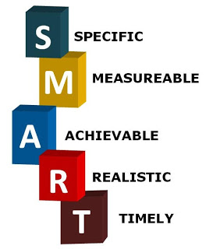
Step 2 – Write SMART Goals
Effective goals should be
  Specific
  Measurable
  Attainable
  Realistic
  Timely
Goals need to challenge your skills and abilities, without discouraging your effort and performance.

Slide 5

Step 3- Know Why You Want to Achieve Your Goals
If you want to succeed at a goal, you need to understand why you want it.
Knowing “why” gives you strength, power, and motivation.
Knowing “why” helps you get the job done.

Slide 6

Step 4 – Identify Obstacles
Effective goals are analyzed for potential problems.
Think of the things that may keep you from reaching your goal.
Take action to resolve or minimize problems before they occur.

Slide 7

Step 5 – Manage Your Goals/Set Deadlines
Effective goals are manageable.
Divide a large, overwhelming goal into smaller components when possible.
Types of goals:
  Big picture goals – not achievable in one simple step, takes a journey
  Milestone goals – series of goals that will take you to your destination
  Mini goals – milestone goals that are broken down to make them more manageable

Slide 8

Step 6 – Make a Plan of Action
Make a plan!
Use what you’ve done in Step 4 and Step 5 to make a plan of action!
Put down activities you need to do in order of importance.

Slide 9
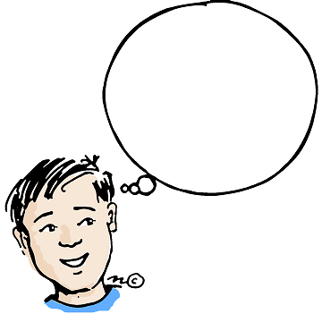

Step 7 – Visualize Your Achievement
Picture yourself reaching your goal.
Picture the result, the moment, and your feelings.
The more you desire something, the harder you will work toward achieving it.

