Slide 1
1.03 Business Communication
Select and utilize appropriate formats for professional writing

Slide 2
Ways to Communicate in Business
In person
Email
Letter
Phone
Memo
Can you think of other ways to communicate?

Slide 3
Business Communication involves exchange of information within an organizational setup
Business Communication can be written or oral
Written messages can be saved for future reference
Internal written communication - employers and employees at all levels of the company
External written communication - clients, independent contractors, industry colleagues and other individuals not working directly for the company
Modern communication - text messaging, social networking posts, and multimedia business presentations.

Slide 4
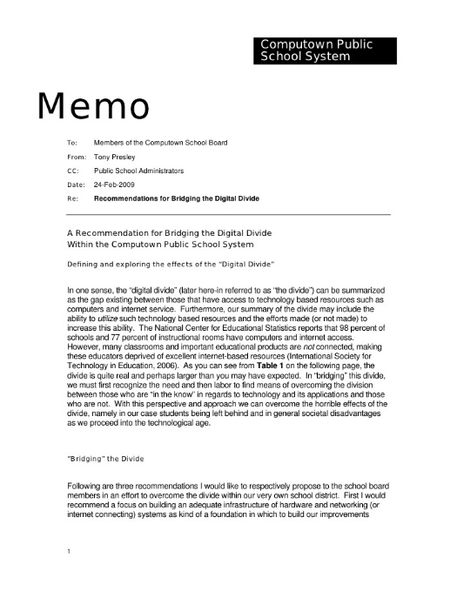
Memorandum (or Memo)
Memos are generally short means of written communication within an organization
Mainly used by employers and employees to communicate information about current projects, changes in business procedures or other internal topics
They are used to convey specific information to the people within an organization

Slide 5
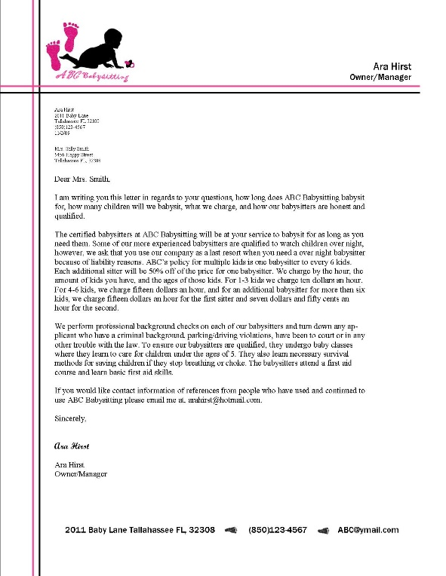
Letter
It must have a good, appealing layout
Divided into paragraphs
It should be carefully written as it has an impact on goodwill of the organization
Business letters can help promote the business image by communicating with the outside world
Can be used to confirm in writing what has been agreed upon verbally
Examples of Business letters are - sales letters, information letters, complaint letters, etc

Slide 6
Email
Has become a common form of written communication in business because of its rapid delivery, ease of use and ability to reach large audiences
Email has become “equally admissible” in court as formal paper documents
Continues to grow as a form of written business communication

Slide 7
Tips
Create an outline before crafting written communication for brevity, clarity, and succinctness
Offer additional resources for continuing communication, such as a telephone number, fax number or email address
Use bullet points and numbered lists for simplicity
Written business communication should conclude with a call to action
Follow up with a telephone call when possible
If unsure of the recipient’s name, address the note as “Dear Sir or Madam”

Slide 8
Web Sources
http://ezinearticles.com/?Written-Business-Communication&id=1742649
http://smallbusiness.chron.com/written-communication-business-2935.html

